Slide 1

Welcome to the Orientation Day – Fall 2023
Please have a seat. We will begin shortly.

Slide 2
Notes:
IGNORE (Animation Slide)

Slide 3
Notes:
IGNORE (Animation Slide)

Slide 4
S
U
R
E
Notes:
IGNORE (Animation Slide)

Slide 5
ACTIVITY ONE
Notes:
Let's us begin they day with an activity!

Slide 6

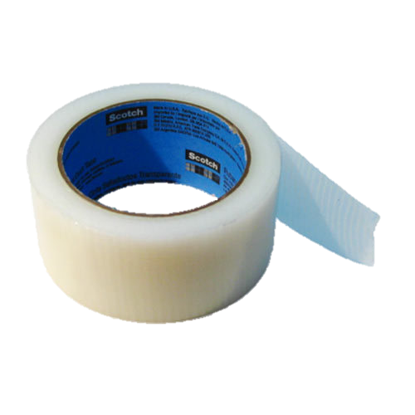


MARSHMELLOW & SPAGHETTI CHALLENGE
In 45 minutes, build the tallest free-standing structure out of 20 spaghetti sticks, 1 meter of tape, 1 meter of string, and 1 marshmallow. The marshmallow is to be only placed on top.
20 Spaghetti Sticks
1 Meter of Tape
1 Meter of String
1 Marshmallow
Notes:
All team members must plan and then work together to find a way to build the tallest and steadiest tower that is built out of spaghetti and tape and has the piece of marshmallow on the top of the tower. The usage of any other stationary or equipment is prohibited. Good luck!
Instructions for the instructor:
To monitor the progress and the difficulties that each team witnessed to be able to effectively connect their experience in this challenge as examples that will be taken with the topic of team dynamics later on. Also, to answer any questions that they may have, and to keep track of the time, and to make sure that everyone is following the rules correctly.
Objective:
This activity will work as an ice-breaker for team members to get to know each other, and for the instructor to gather some notes about each team to help them improve on them in the next challenge for the team to be as effective as possible.

Slide 7





I . DEFINITION
Notes:
IGNORE (Animation Slide)

Slide 8
I . DEFINITION
They are the dynamics that relate to the behaviors and relationships between the various members of the team, and their strengths and weaknesses.
Notes:
IGNORE (Animation Slide)

Slide 9
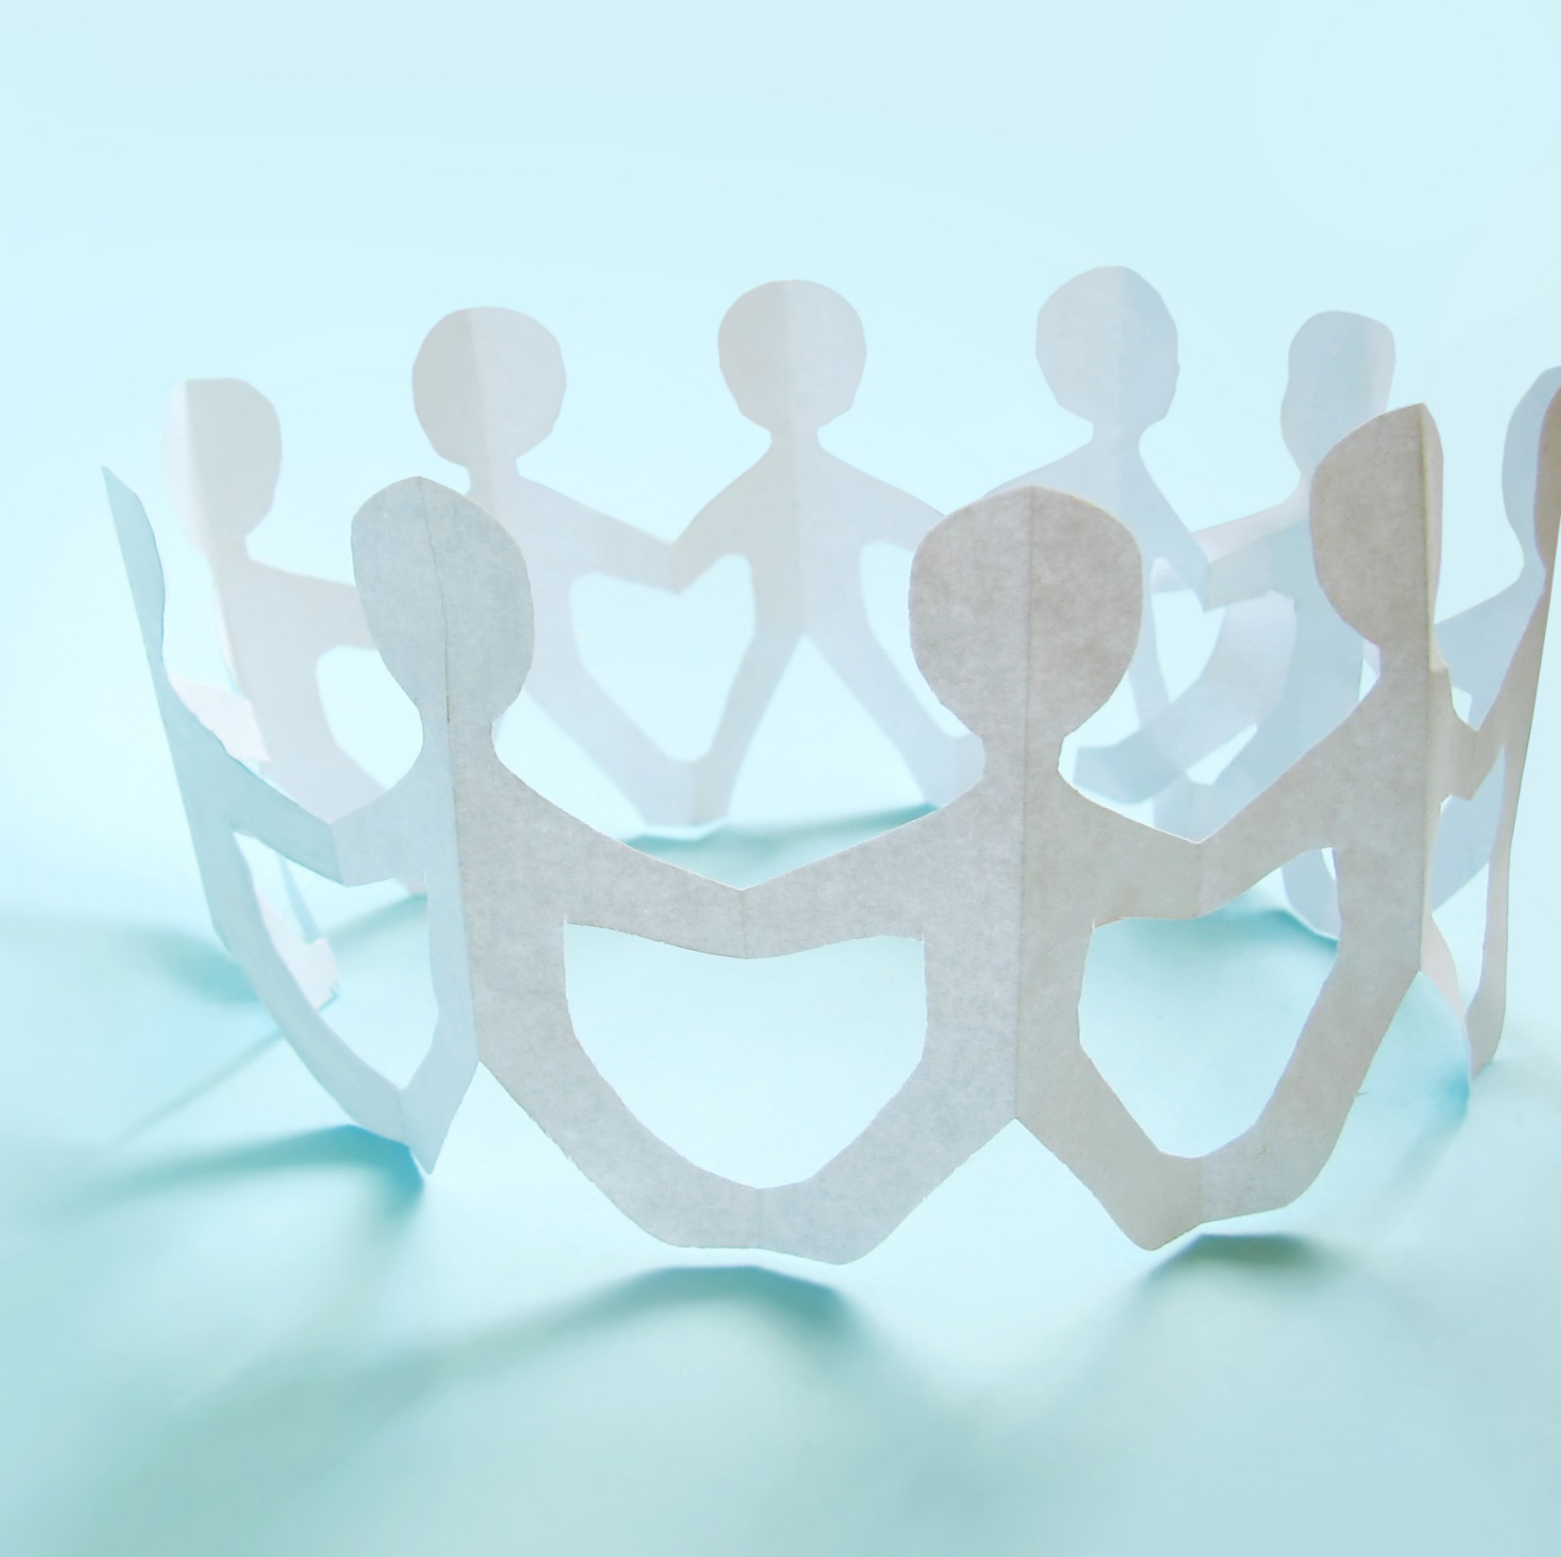
I . DEFINITION
Team dynamics are the dynamics that relate to the behaviors and relationships between the various members of the team, and their strengths and weaknesses.
Notes:
We use these team dynamics whenever we are interacting with the team whether it was on a daily basis, or any kind of shared work that requires the direct interaction between them.

Slide 10
II . CHARACTERISTICS OF WINNING TEAM DYNAMICS
Shared Purpose.
2. Trust and Openness.
3. Healthy Team Environment.
4. Accept Constructive Criticism.
5. Participative Leadership.
Notes:
The top five characteristics of winning team dynamics are the following:

Slide 11
II . CHARACTERISTICS OF WINNING TEAM DYNAMICS
Shared Purpose.
Notes:
The main difference between a group and a team is that the team has a goal to work on, unlike the group. So, we as a team decided on a goal that is “SMART” (Specific, Measurable, Achievable, Relevant, and Time-bounded) and worked on it as a team. Also, to get the best work from the team we avoided using individual work and focused on working together. (DeakinCo., 2017)

Slide 12
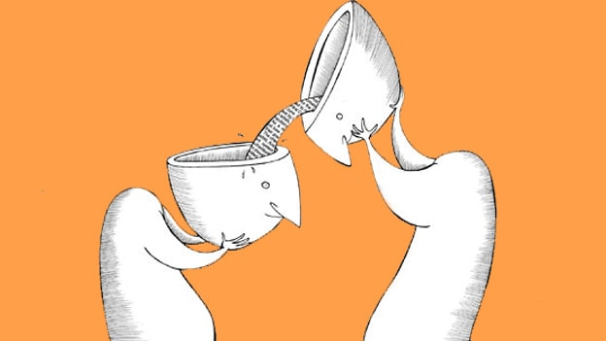

II . CHARACTERISTICS OF WINNING TEAM DYNAMICS
2. Trust and Openness.
Notes:
Sharing ideas and information between team members is a must, but sometimes we see group members that deny the ideas that are not suggested to them. Which causes others in the group to stop sharing ideas and feel like they are not necessary for the group. So, any suggested idea should be noted and written then the team will think and decide if that idea is suitable. (DeakinCo., 2017)

Slide 13

II . CHARACTERISTICS OF WINNING TEAM DYNAMICS
3. Healthy Team Environment.
Notes:
Usually working in a comfortable area bring new ideas and efficient ones unlike working under stiffness. So, adding some sense of humour between the team members will make the team more active and will increase the bond between the members. (DeakinCo., 2017)

Slide 14

II . CHARACTERISTICS OF WINNING TEAM DYNAMICS
4. Accept Constructive Criticism.
Notes:
In normal teams, the members usually have various skills so the team should ask his team member who might be more professional than him. Also, he should accept constructive criticism from others and don’t look at it as if it was insulting. (DeakinCo., 2017)

Slide 15

II . CHARACTERISTICS OF WINNING TEAM DYNAMICS
5. Participative Leadership.
Notes:
A team leader should have some essential characteristics, such as being, an active listener, confident, positive, committed, honest, integrity and having a future vision. And all these characteristics are hard to be acquired so the team leader should be given to the person who has almost all those characteristics. (DeakinCo., 2017)

Slide 16



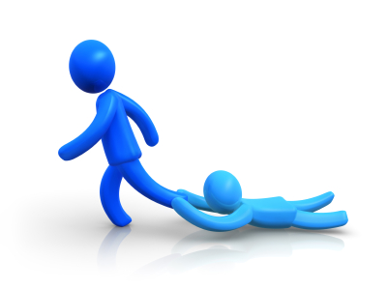
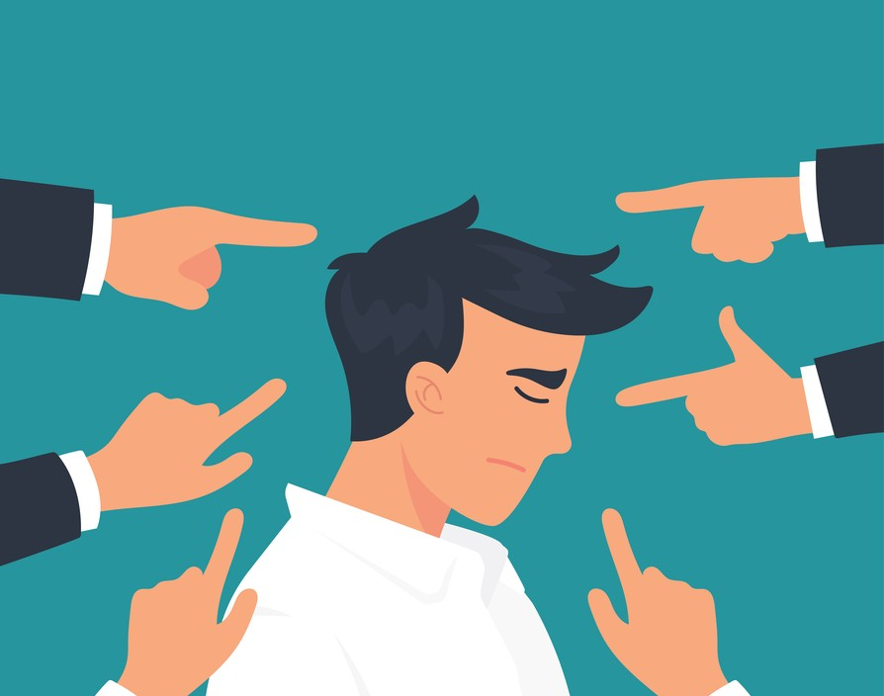
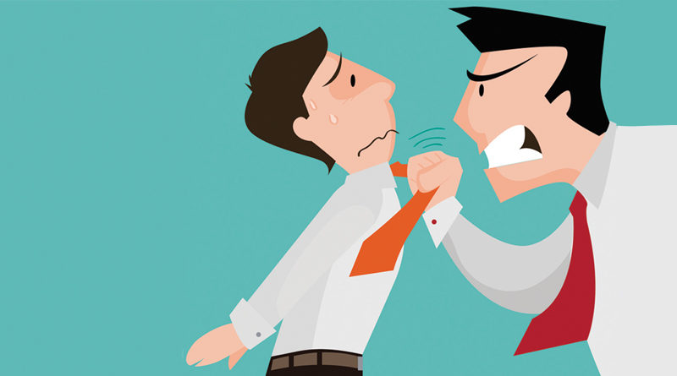

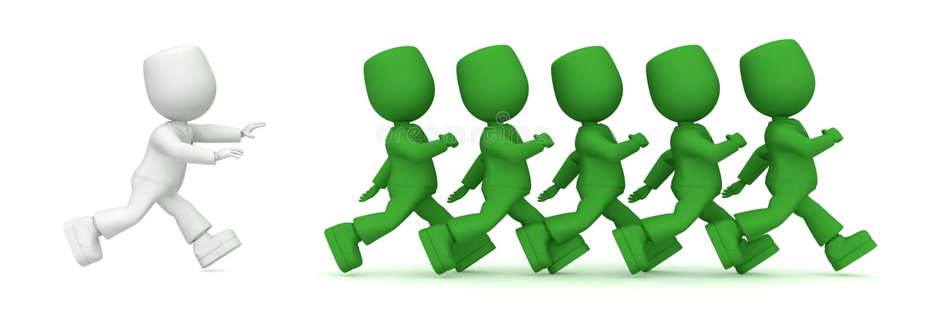
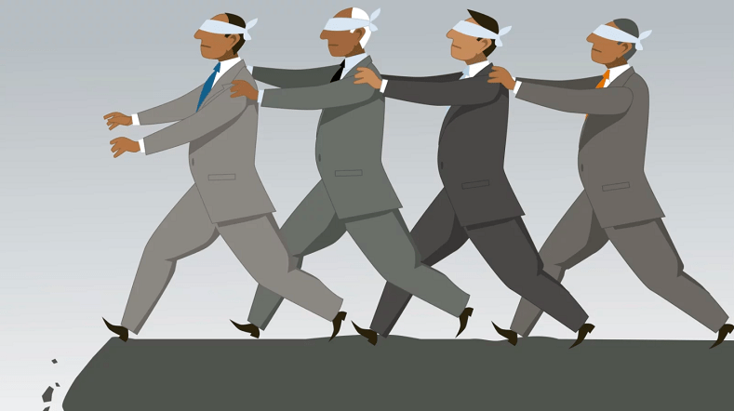
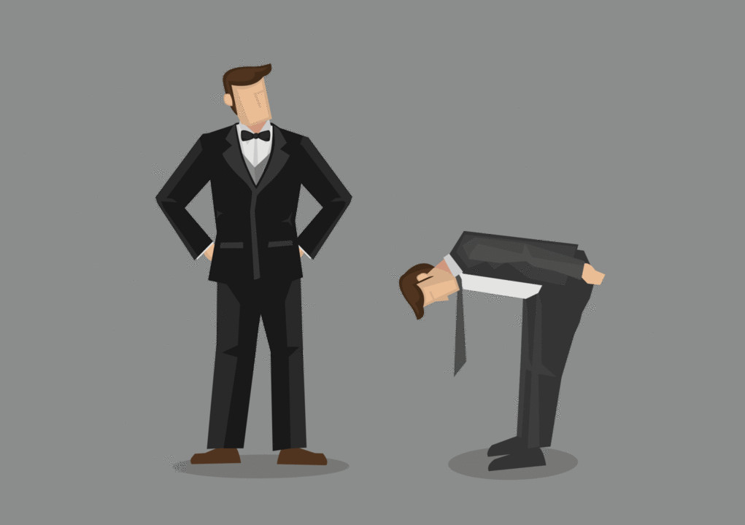

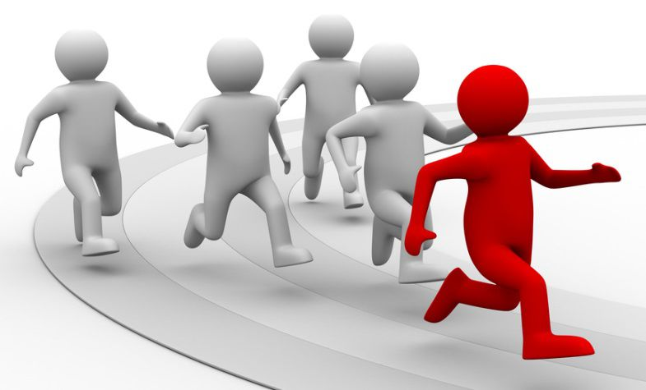
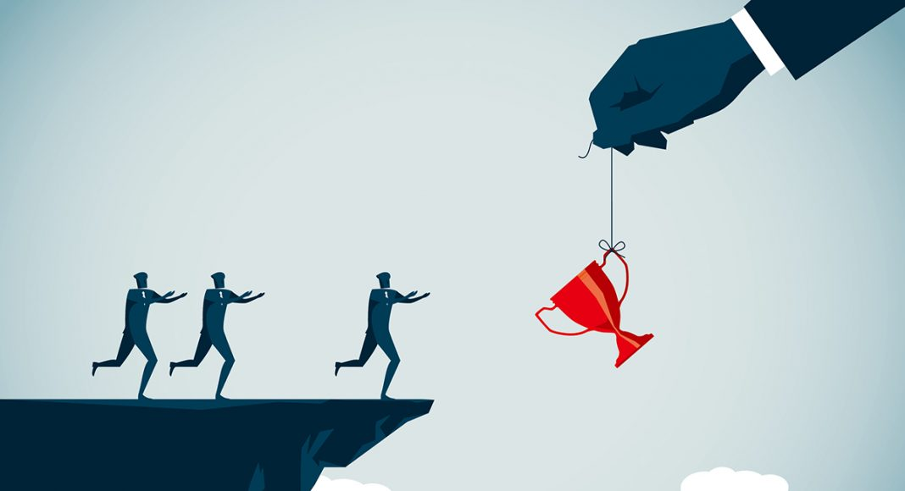
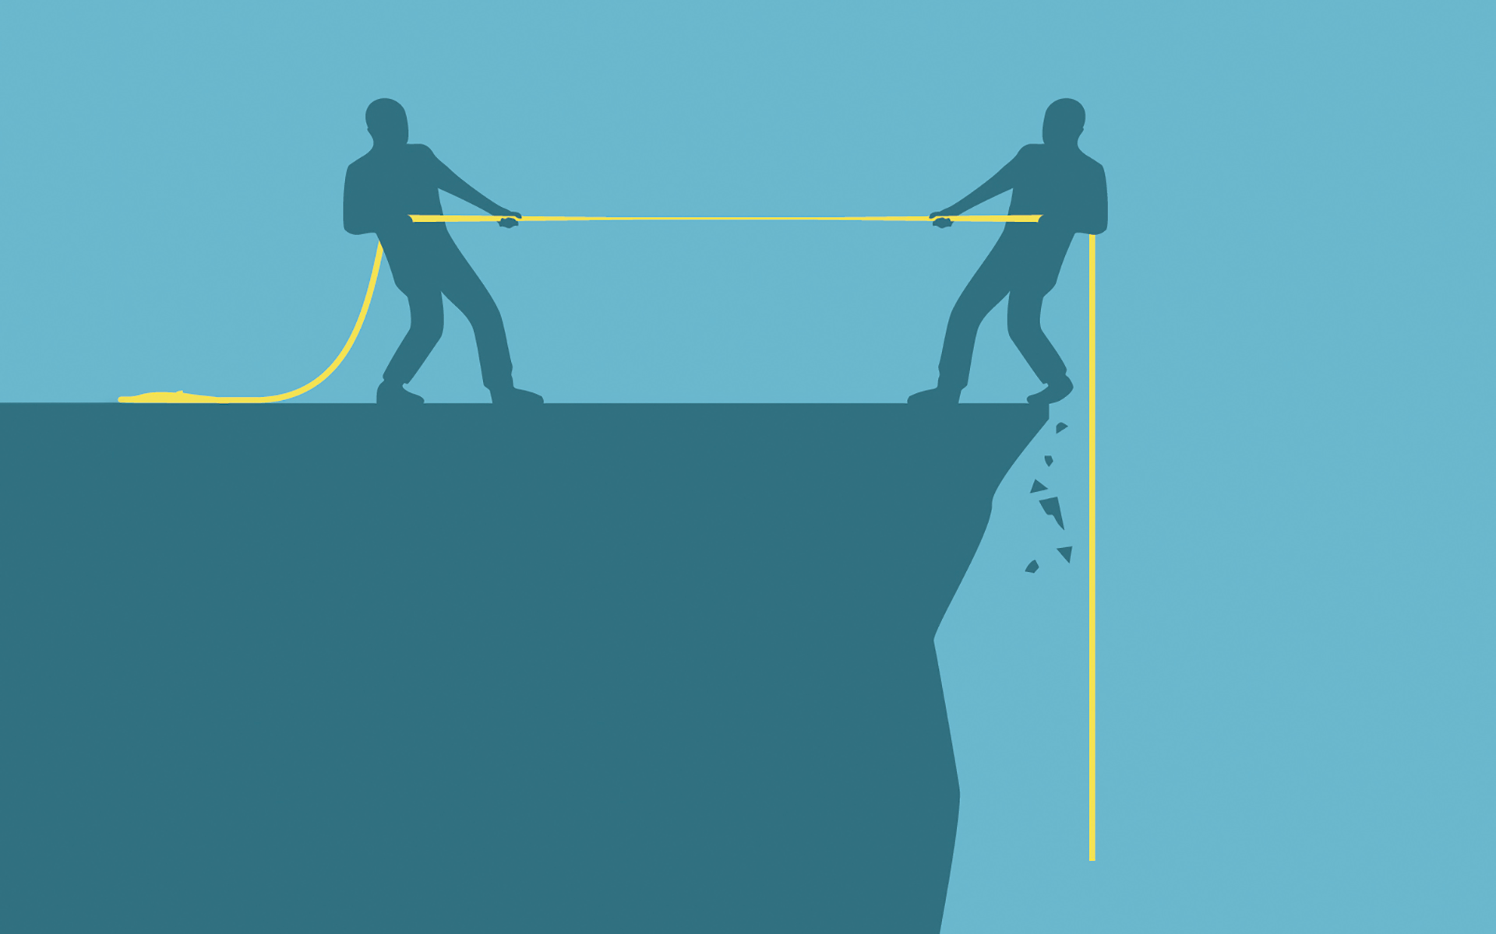
III. POOR TEAM DYNAMICS
Excessive Deference to Authority
Overly Competitive Environment
Groupthink
Large Team Size
"MY RULE OF THUMB IS THAT NO WORK TEAM SHOULD HAVE MEMBERSHIP IN THE DOUBLE DIGITS (AND MY PREFERRED SIZE IS SIX), SINCE OUR RESEARCH HAS SHOWN THAT THE NUMBER OF PERFORMANCE PROBLEMS A TEAM ENCOUNTERS INCREASES EXPONENTIALLY AS TEAM SIZE INCREASES.“ J RICHARD HACKMAN
Fear of Being Judged
Free Riding
Negative Behaviours
Weak Leadership
Notes:
(Barron, 2022; Mind Tools, 2019)
Weak leadership
This happens when the team lacks a strong leader, some members will not perform their tasks seriously, and others will feel that they are left out without getting their roles specified clearly. That’s all result conflicts and lack of direction.
Excessive Deference to Authority
This situation happens when team members are more concerned with pleasing the leader rather than reaching their goal. thus, group members might hold back their own opinion to prevent any possible conflict with the leader.
Overly Competitive Environment
When the members of the group become too competitive, that lead to an unhealthy work dynamic. As a consequence, they may refuse to corporate and help each other or they might lose the feeling of working toward the same goal.
Groupthink
Groupthink occurs when group members become more interested in reaching a mutual agreement rather than exploring alternative options. This might decrease the probability of finding creative solutions which could be more suitable.
Large Team size
Harvard team dynamics expert, J Richard Hackman, who studied team dynamics for decades, says:
"My rule of thumb is that no work team should have membership in the double digits (and my preferred size is six), since our research has shown that the number of performance problems a team encounters increases exponentially as team size increases.“
Fear of Being Judged
Some team members are sensitive to criticism so they hold back their opinions and ideas and do not share any of it. This prevent the team from finding better solutions to the problem in hand.
Free riding
Some team members taking it easy to rely on other members to achieve their tasks.
Negative behaviors
Aggressiveness, negativity, credit-seeking and even joking in the wrong time are considered disturbance behaviors.

Slide 17

IV . STRATEGIES TO IMPROVE TEAM DYNAMICS
Tackle problems quickly with good feedback.
Notes:
To have the ability to notice any changes with any of the team members’ behaviors that have a negative impact on the group’s productivity and efficiency.
This calls to provide feedback to that team member as soon as possible, and to encourage them to improve on those behaviors and to help in increasing the team’s productivity. (Guthrie, n.d.; Mind Tools, 2019)
You also must encourage the team to have open discussions when any conflict occurs which will help the team to return to their positive team dynamics.

Slide 18

IV . STRATEGIES TO IMPROVE TEAM DYNAMICS
2. Define roles and responsibilities.
Notes:
For a team to be successful, it must have a clear vision on what the end goal is and how they are going to reach it, and this requires that each member in the team knows what their roles and responsibilities as soon as the team gets formed. (Guthrie, n.d.; Mind Tools, 2019)

Slide 19


IV . STRATEGIES TO IMPROVE TEAM DYNAMICS
3. Break down barriers.
Notes:
Breaking down the barriers between team members and knowing each other cannot be done overnight, but by regularly conducting ice-breaker activities and team building exercises can help in bridging the gap between team members faster and it will help in building strong relationships and strong team dynamics in the team. (Guthrie, n.d.; Mind Tools, 2019)

Slide 20


IV . STRATEGIES TO IMPROVE TEAM DYNAMICS
4. Focus on communication.
Notes:
Open discussions and effective communication are essential for any successful team to ensure clear communication between all team members. This includes all forms of communication including verbal, non-verbal, written, etc…
Effective communication requires having regular feedback to ensure that the message was received and understood. Also, keeping team members in the loop and letting them in on any updates that happens will help in making them feel more included. (Guthrie, n.d.; Mind Tools, 2019)

Slide 21

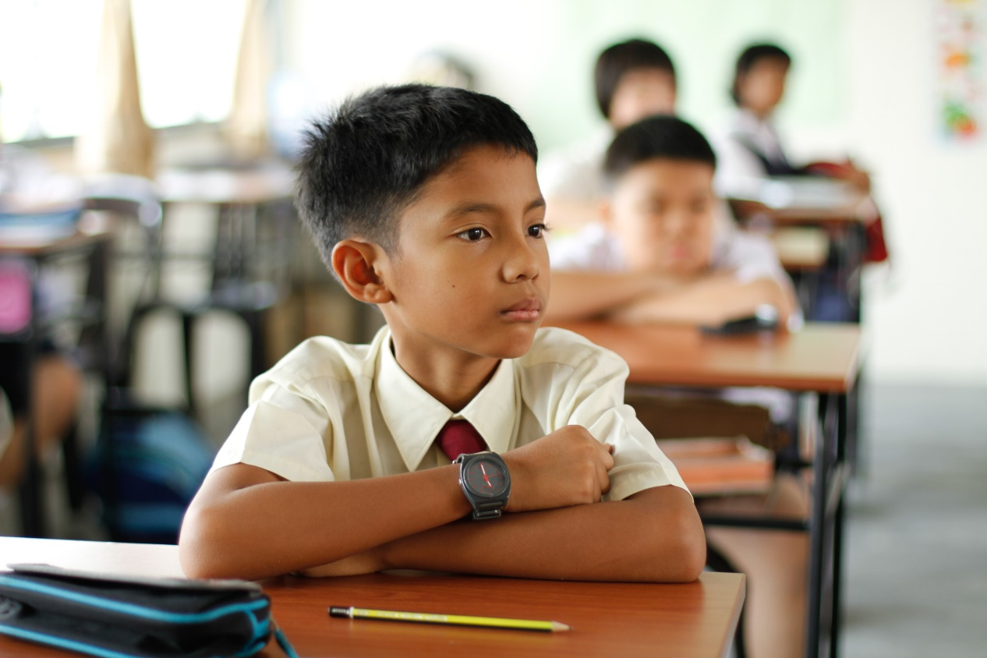
IV . STRATEGIES TO IMPROVE TEAM DYNAMICS
5. Pay attention.
Notes:
As a member of the team, you must know everything that is going on that relates to your team. You also must keep your attention on any warning signs or red flags that might appear when working in the team that shows that your team has poor group dynamics. (Guthrie, n.d.; Mind Tools, 2019)

Slide 22
ACTIVITY TWO
Notes:
Woohoo! Another activity... Hmm... what is about this time?!

Slide 23

PAPER CHAIN CHALLENGE
You have 15 minutes to come up with a plan to make the longest and sturdiest paper chain. After this, you will not be allowed to communicate verbally, so make sure to establish some non-verbal communication tactics.
Notes:
You are not allowed to use any other stationary or equipment other than the ones that are provided by the instructor. Once the activity begins, verbal communication will not be allowed. Each of you may use only one hand while doing the challenge. Good luck!
Instructions for the instructor:
Firstly, to meet with the team leaders, and to explain their task and all of the rules that they have to follow. To monitor the progress and the difficulties that each team witnessed to be able to give them feedback to improve on their teamwork skills. Also, to answer any questions that they may have, and to keep track of the time, and to make sure that everyone is following the rules correctly.
Objective:
To enhance their teamwork skills, and their non-verbal communication skills as well.

Slide 24

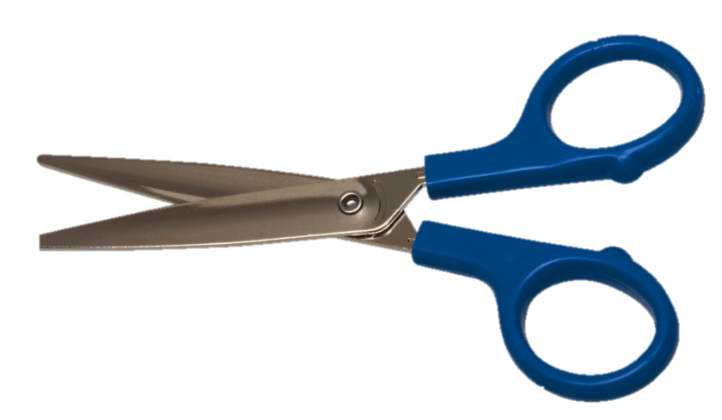
PAPER CHAIN CHALLENGE
In 45 minutes, craft the longest and sturdiest paper chain you can using non-verbal communication only. You will only be given the following materials:
10 A4 Papers
1 Roll of Tape
1 Scissors
Notes:
You are not allowed to use any other stationary or equipment other than the ones that are provided by the instructor. Once the activity begins, verbal communication will not be allowed. Each of you may use only one hand while doing the challenge. Good luck!

Slide 25
REFERENCES
Barron, B. (2022). What Is Group (Team) Dynamics? Definition & Tips, [online] Business Envato Tuts. Available at: https://business.tutsplus.com/tutorials/what-is-group-team-dynamics--cms-40100.
DeakinCo. (2017). 6 strategies for managing and improving team dynamics. [online] DeakinCo, Powering workplace performance. Available at: https://www.deakinco.com/resource/6-strategies-for-managing-and-improving-team-dynamics/.
Guthrie, R. (n.d.). Understanding Team Dynamics, RallyBright. [online] www.rallybright.com. Available at: https://www.rallybright.com/understanding-team-dynamics.
Mind Tools (2019). Improving Group Dynamics & Helping Your Team Work More Effectively. [online] Mindtools.com. Available at: https://www.mindtools.com/pages/article/improving-group-dynamics.htm.
Wrike.com. (2018). Ultimate Guide to Team Building Activities That Don’t Suck. [online] Available at: https://www.wrike.com/blog/ultimate-guide-team-building-activities/.

